Slide 1


Welcome
To presentation

Slide 2
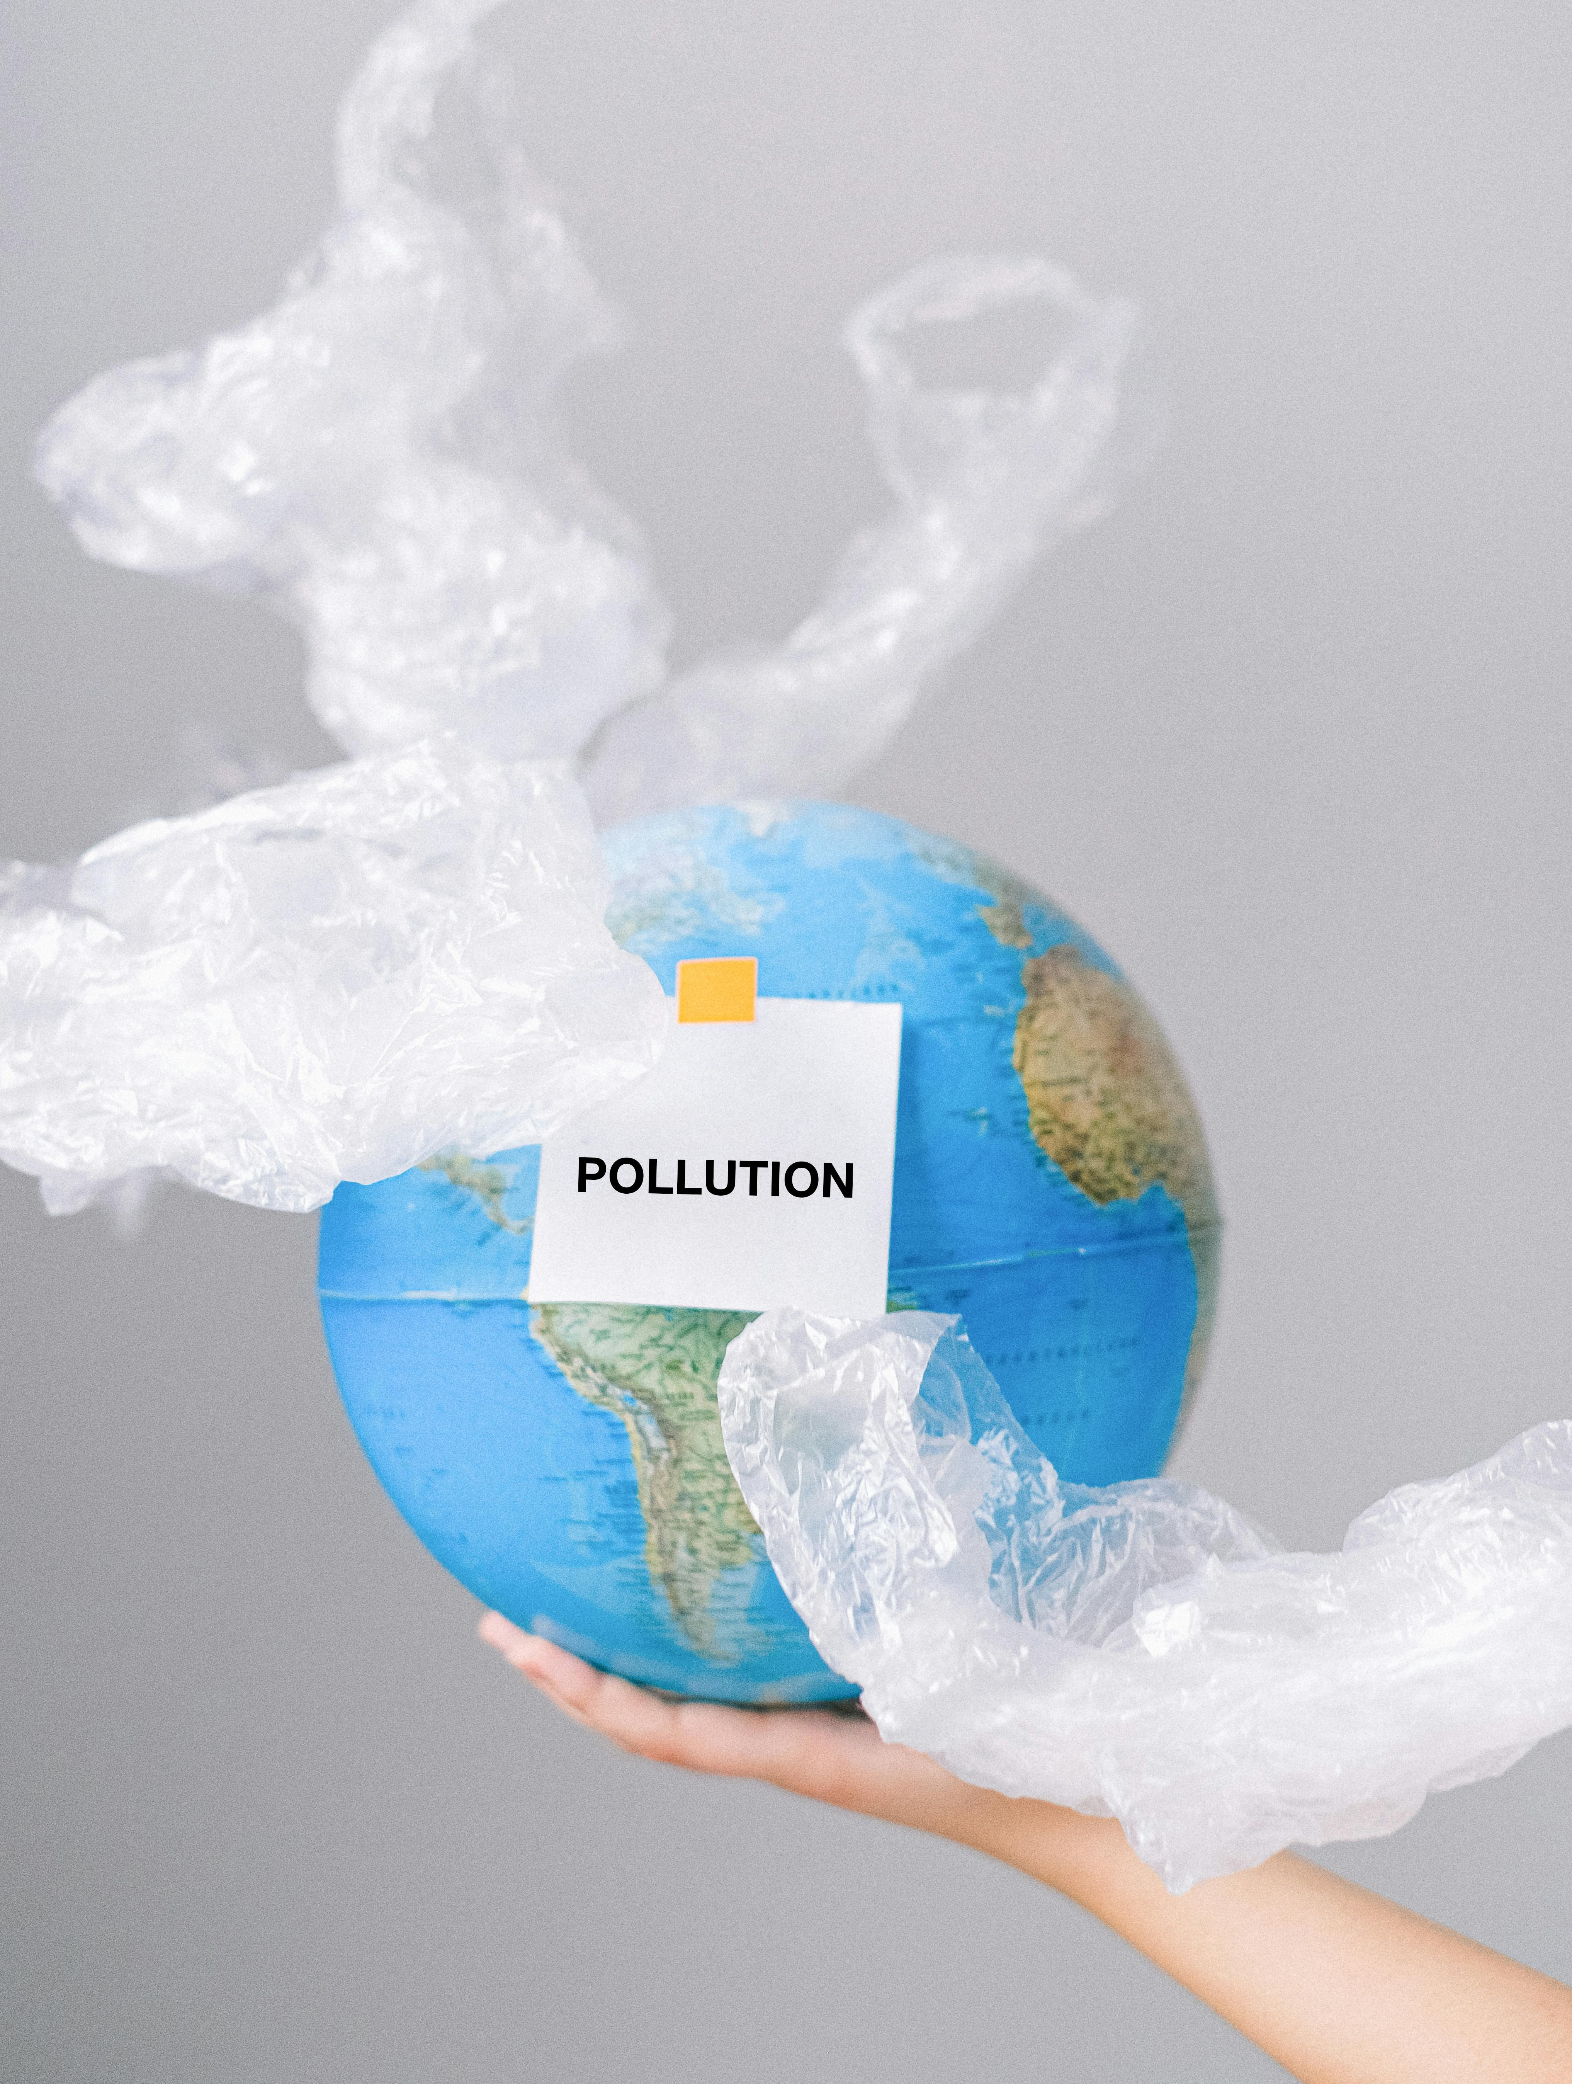
The Growing Threat of Environment Pollution
Environmental pollution poses a growing threat to our planet's health and well-being. From air and water contamination to soil degradation, the consequences are far-reaching, impacting human health, ecosystems, and the future of our world.

Slide 3

Causes of Environment pollution
Industrial Emissions
Transportation
Waste Management
Vehicles, particularly those powered by fossil fuels, emit significant amounts of air pollutants, contributing to smog and respiratory issues.
Factories and industrial facilities release harmful pollutants, including greenhouse gases and toxic chemicals, into the atmosphere.
Improper waste disposal and lack of recycling lead to land and water pollution, threatening ecosystems and public health.

Slide 4
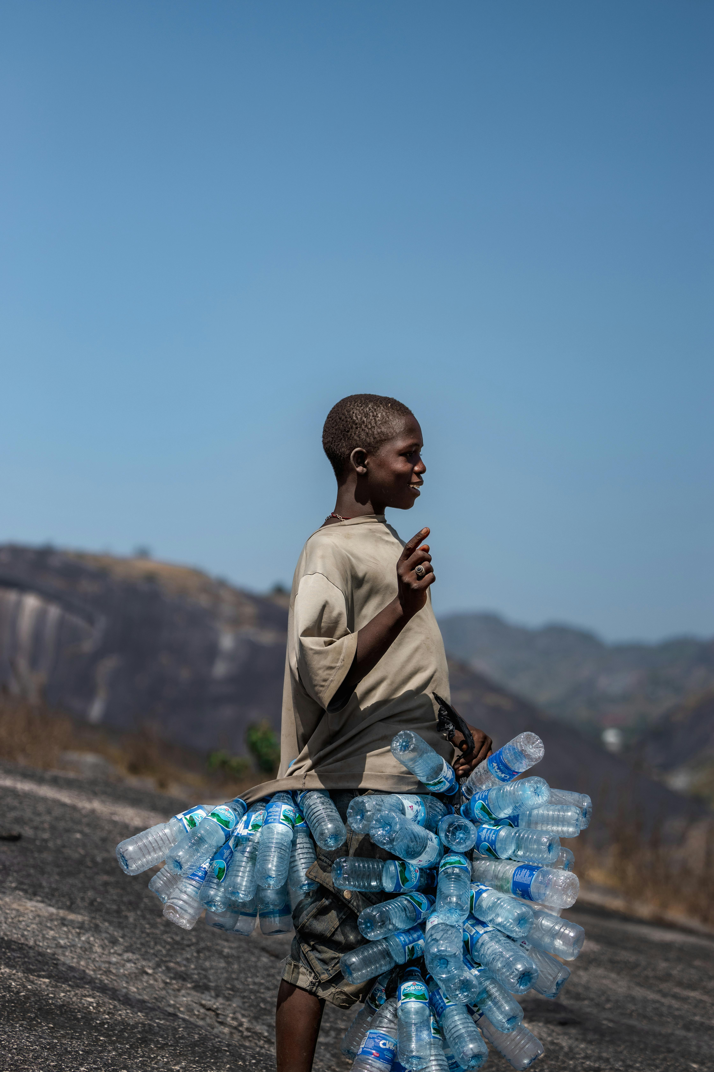
The Impact on Human Health and Ecosystems
Respiratory Issues
Air pollution contributes to respiratory illnesses like asthma, bronchitis, and lung cancer, impacting millions worldwide
Waterborne Diseases
Contaminated water sources can spread infectious diseases like cholera, typhoid, and dysentery, posing serious health risks.
Biodiversity loss
Pollution disrupts ecosystems, leading to habitat destruction, species extinction, and imbalances in natural cycles.

Slide 5
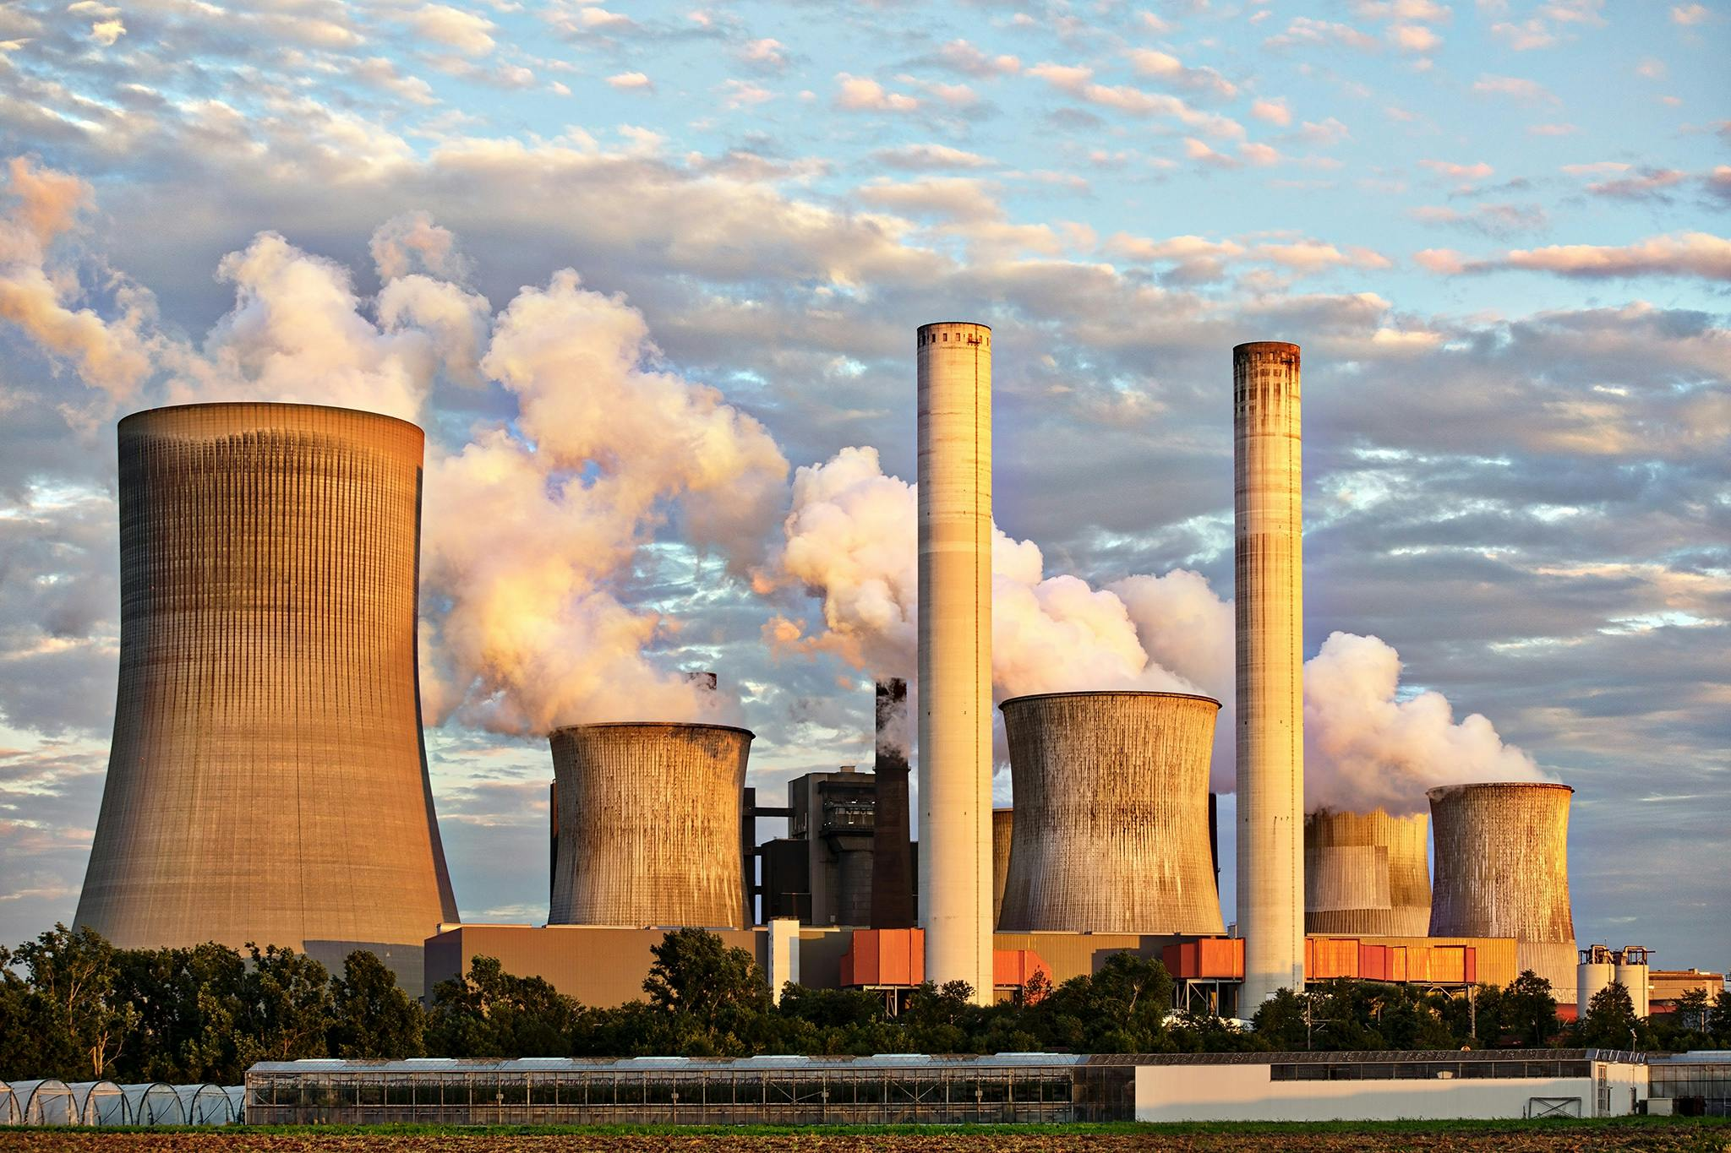


Strategies for Reducing Environmental Pollution
Reduce, Reuse, Recycle
Proper waste management, recycling programs, and reducing consumption are crucial steps in minimizing pollution.
Renewable Energy
Transitioning to renewable energy sources like solar and wind power can significantly reduce
Greenhouse gas emissions.
Reforestation
Planting trees helps absorb carbon dioxide from the atmosphere and improve air quality, mitigating climate change.

Slide 6

Call to Action: Individual and collective Responsibility
Reducing environmental pollution requires individual and collective action. We can all contribute by adopting sustainable practices, supporting environmental initiatives, and advocating for policy changes. Together, we can create a healthier and more sustainable future for generations to come.

Slide 7
Thank you

